Slide 1
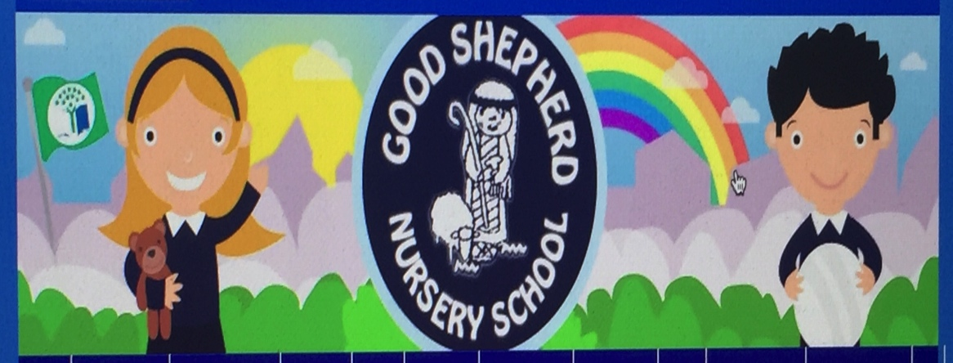
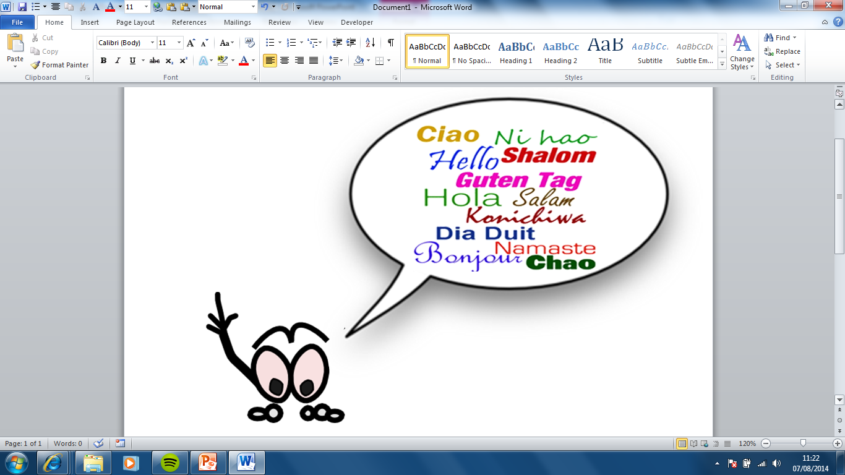
Information about
Good Shepherd Nursery School 2021.

Slide 2
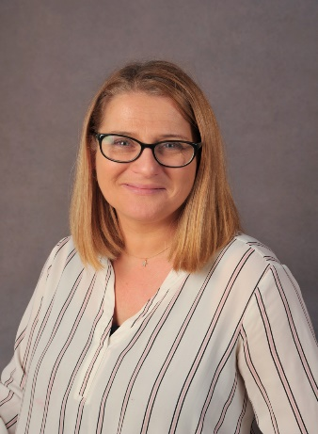
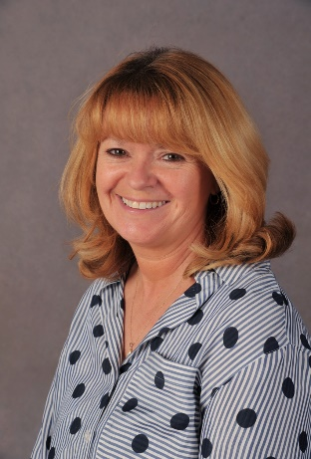
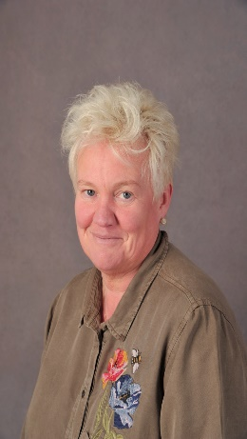
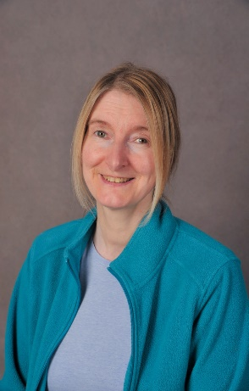
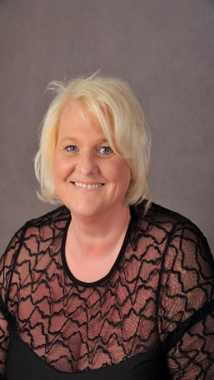
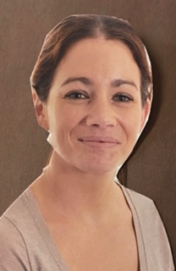
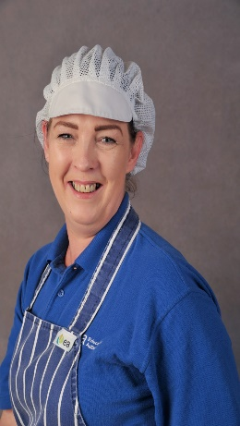
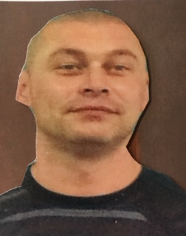


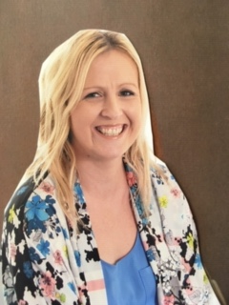
staff
                Our Staff
Principal : Mrs Claire Le Mahieu
Assistant Teacher-jobshare : Mrs Denise Murney
Assistant Teacher- jobshare : Mrs Dolores Mohan
Nursery Assistants : Miss Denise Mc Clinton (part time)
Mrs Marie Therese Griffin –Speech Lang Support
Mrs Joanne Gray (part-time)
Mrs Patricia Mc Veigh
Dining Attendant: Mrs Deborah Kinney
Clerical Officers: Mrs Marie Therese Griffin /Marie Mc Clean
Building Supervisor: Mr SeanTopping

Slide 3
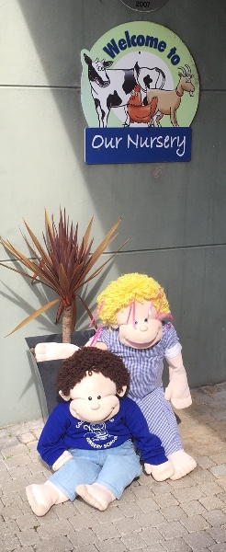

WELCOMe
Thank you for choosing Good Shepherd Nursery for your child’s pre-school education. Staff here aim to give your child excellent pre-school education that will support their development and enable them to reach their full potential .
We hope your child will have an enjoyable year with us and during this year we will endeavour to ensure the he/she has a happy and rewarding start to his/her school life.
We have an open door policy and encourage parents to approach us with any queries or worries. Unfortunately due to the unusual circumstances we are all facing, we would ask parents to message us privately via Seesaw when arranging meetings. We recognise and value the important role that parent’s play in their child’s education. Every effort is made to ensure that parents feel welcome , that they are made aware of the nursery’s mission statement , aims policies and of their child’s individual needs, progress and achievements.
Good Shepherd Nursery School is a progressive, vibrant and inclusive nursery. We are very much looking forward to welcoming you and your child.

Slide 4
The Curriculum
In Good Shepherd Nursery School your child will experience a variety of spontaneous and organized adult –led play experiences specific and suitable to their needs.. We create an enabling environment where continuous provision is offered. We follow Guidelines from The Nursery Curriculum-CCEA. And link experiences to 6 areas of play. We offer and plan experiences that motivate, challenge and stimulate every child meeting their physical, social, emotional and cognitive needs at their specific stage of development. Planned experiences are child centred focusing on what individual children need. We encourage active involvement ,discovery, creativity, interaction with peers, sensory exploration and lots of opportunities to learn, repeat and practice skills.
Early Maths
Our children learn and develop by experimenting , exploring and investigating with a wide range of materials. We offer experience in the following areas :
Number Quantity. Space
Time. Size Shape
Pattern. Relationships
The World Around Us
Children are naturally curious about their environment and people around them and we offer a wide variety of experiences. :
Making sense of their world
Exploration of indoor and outdoor environment
Understanding of themselves, their families , immediate surroundings and wider world
Healthy Eating
Personal, Social & Emotional
This area is of utmost importance in all aspects of a child’s life A child’s emotional well being
Respect Creative Independence
Emotions Positive Behaviour
Learning how to self regulate
Developing a positive disposition to learn
Relationships
The Arts
We see art as a pleasurable sensory experience that allows children to freely express themselves. We focus very much on the process rather than the product. Experiences in these areas are a natural means of communication and learning for our children. Children can be creatively through
Art and Design Dance. Music
Drama Movement
Physical development
Children enjoy to revel in freedom of movement and in play that is inventive, stimulating
Gross motor skills are nurtured ,not only because they are important for long term health and wellbeing but they support physical and cognitive development.
Language Development
Language development is crucial to living and learning to communicate with others to share and express feelings, to give understand ideas and develop thoughts. We offer experiences in: Listening, communication, awareness of text and Pre-writing

Slide 5
ReSTART INFORMATION
Covid-19 continues to have profound implications for society and throughout our journey we will continue to follow advice from the PHA, The Department of Education and the EA ,guidance will support us to adjust and adapt any plans and procedures for our nursery that we need to implement to ensure we safeguard everyone in our care.
Please ensure you read all Covid related documentation that has already been sent or will be continued to be shared.
This is a learning curve for us all but rest assured you can be confident and secure in the knowledge that we have a very strong team in Good Shepherd Nursery School and we will endeavour to keep everyone safe. Communication will be key for our partnership.
We are depending on everyone’s support in adhering to our new procedures and intend to keep all lines of communication open so we can move forward harmoniously.

Slide 6




SUPPORTING OUR CHILDREN
We must work together to ensure this is a positive, exciting experience for our children. We know that after prolonged periods of lockdown many of the children will be anxious and worried and we will implement a range of strategies and opportunities to build on their general happiness and confidence and focus on a recovery curriculum with strategies for self-regulation
It is our intention that our pre-school children have a safe, play-based learning experience, appropriate for their age and stage of development, in line with the NI Curricular Guidance for Pre-School Education.
We continue to our revise (depending on situation ) settling in procedures/routines that will focus on the child, building confidence and offering opportunities to have fun and feel content.
We will support the children’s well being with a major thrust on activities that develop their personal, social and emotional skills whilst allowing them to feel safe and secure in our welcoming and comforting environment.
Remote learning will be supported for any children who is unable to attend e.g. those advised not to attend for medical reasons. Good Shepherd Nursery School is prepared for the delivery of remote learning in the event of local or wider school closures, or that a class or group of pupils need to self-isolate.

Slide 7


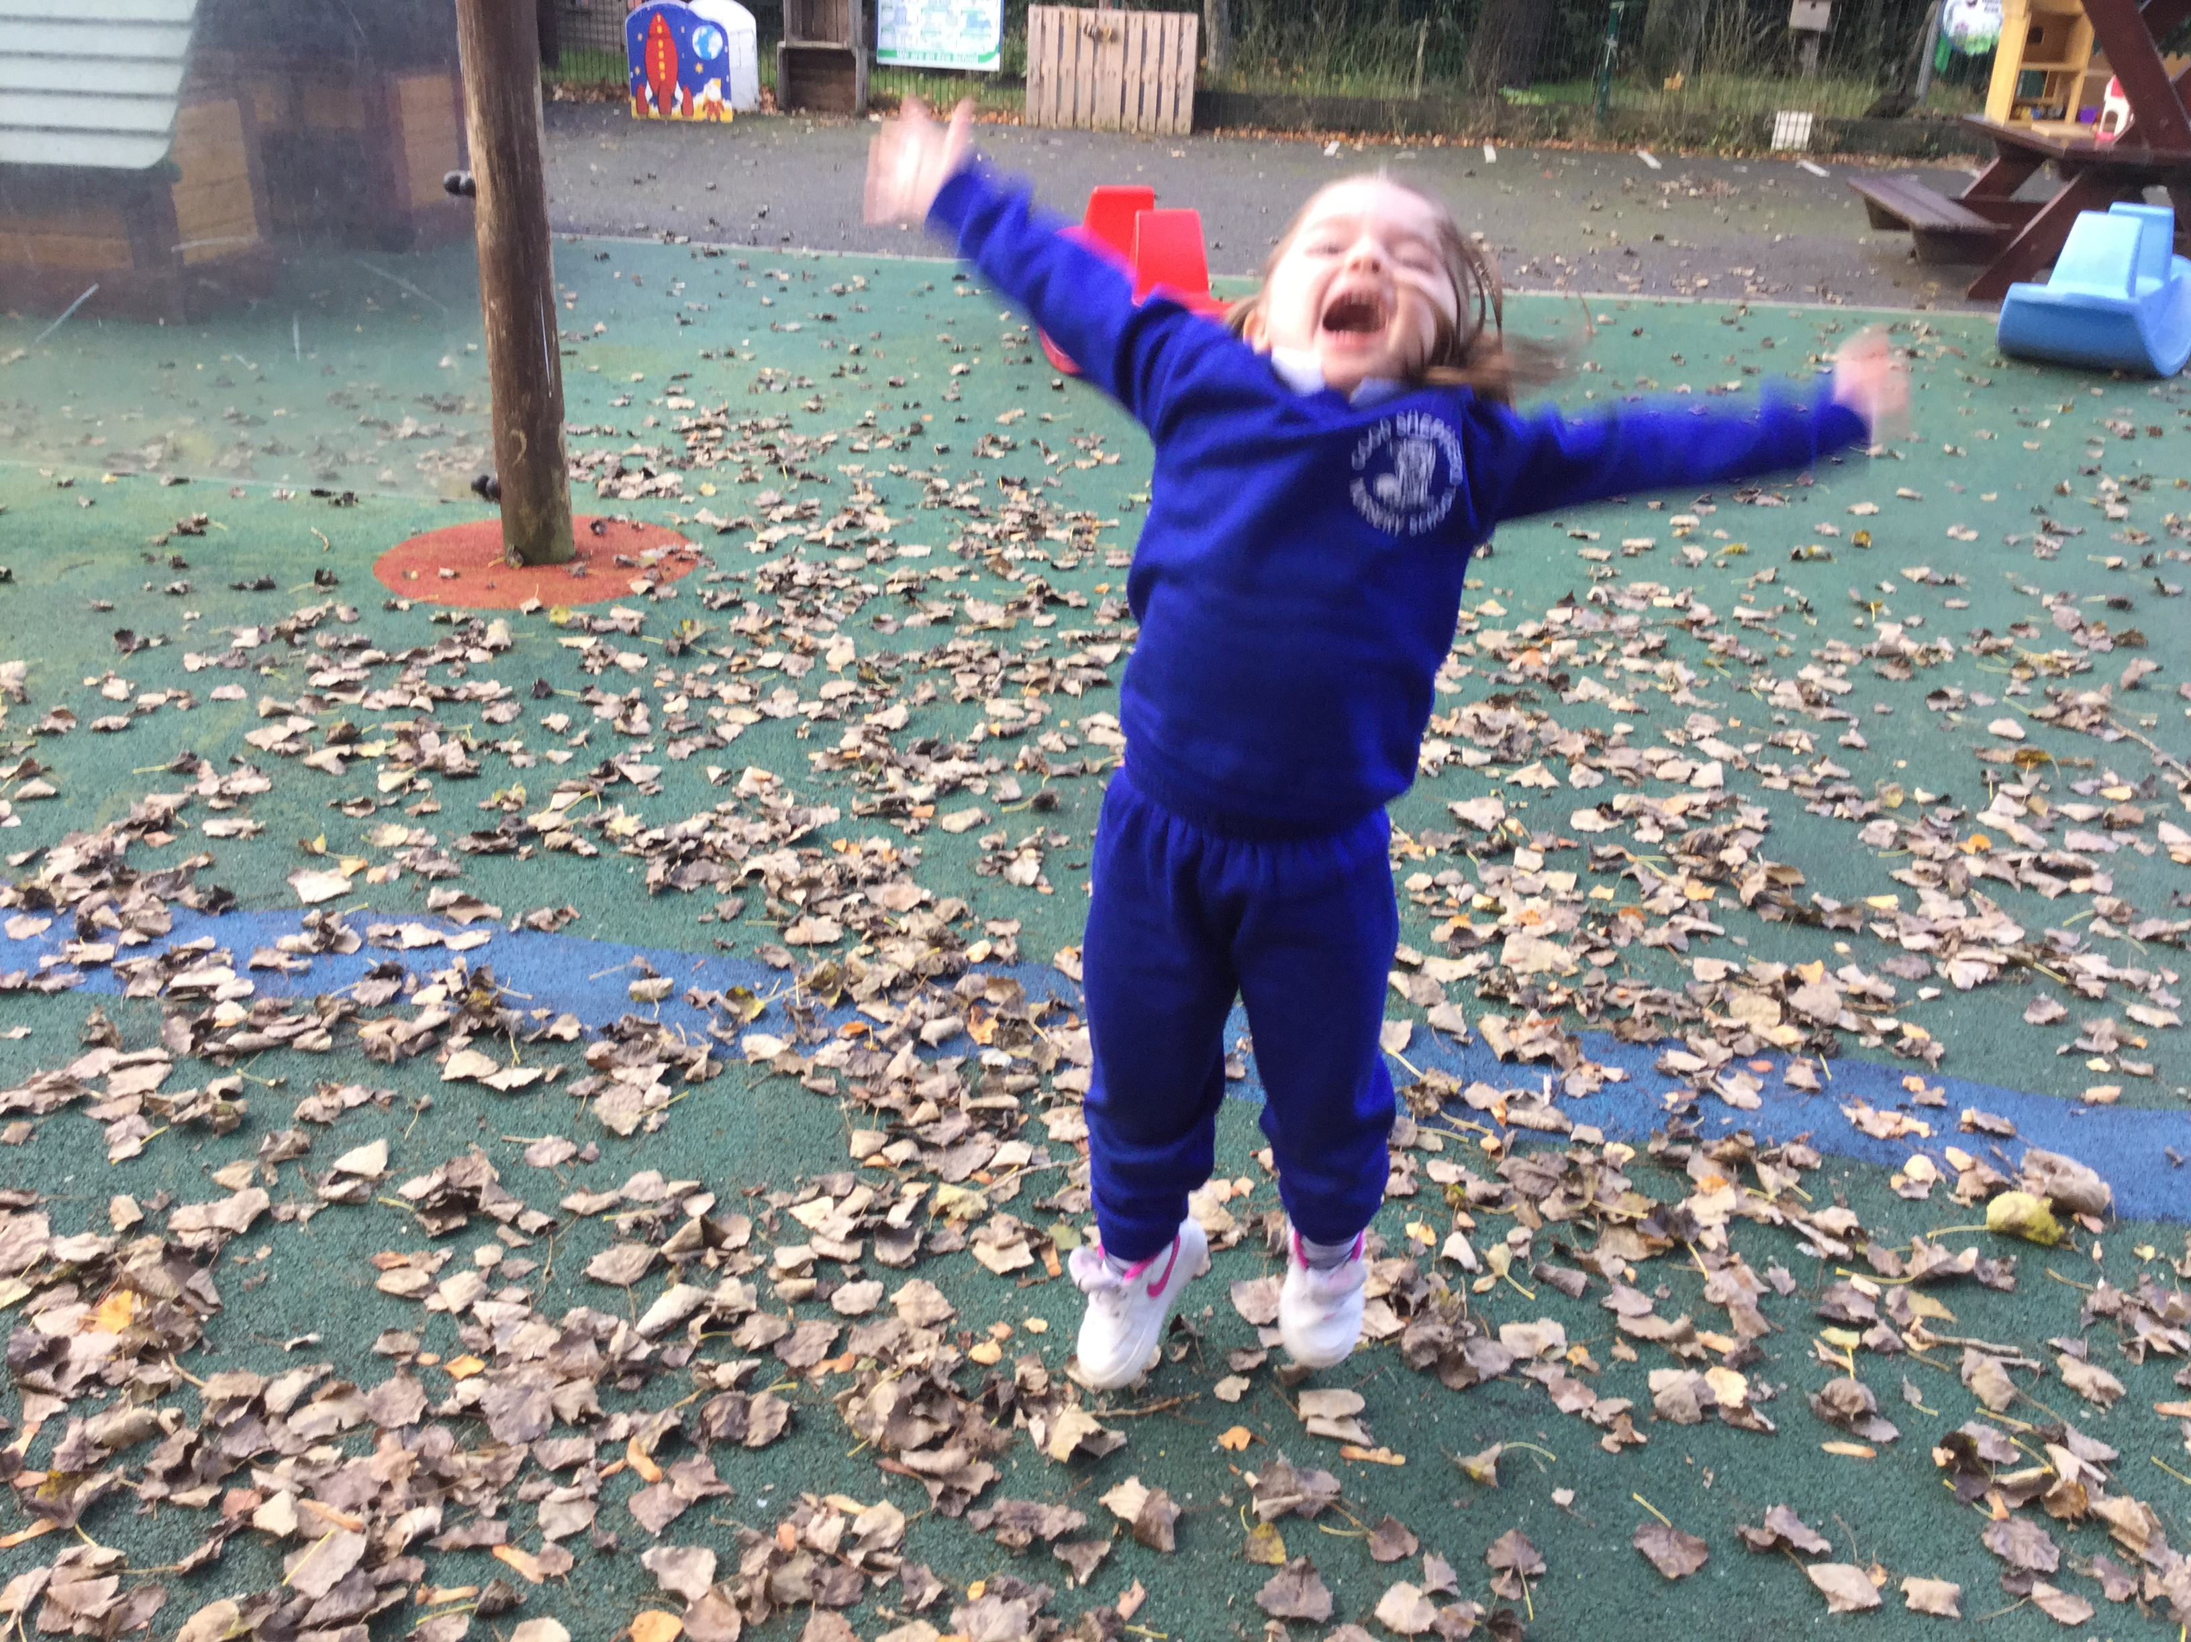
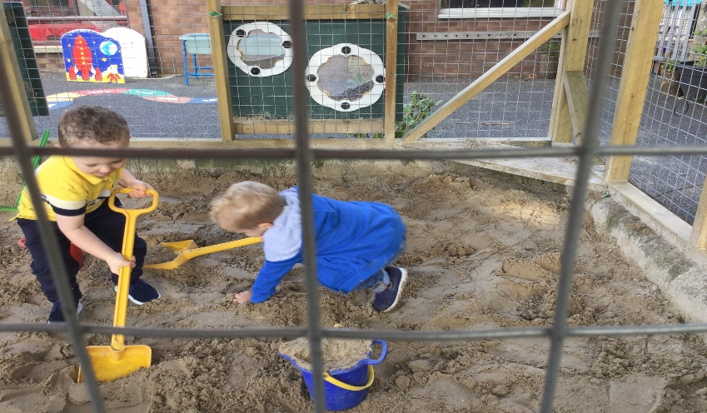
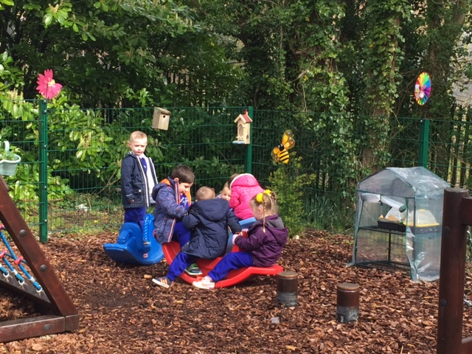
OPEN DAY
Our open day sessions are on the 25th, 26th and 27th August.
It is essential you come at your allocated slot and only 1 parent may attend. This may be altered depending on updated Covid guidance
Children will have an opportunity to become familiar with their new setting having time to play with toys, explore new areas and meet their new teachers and nursery assistants.
In addition to our open days and to have a strong induction process we will provide parents with as much information as possible about what to expect. We will send photographs/power points and a virtual tour of our setting and an outline of what a typical pre-school session might entail. We hope this will help parents to prepare pupils ahead of their first day.

Slide 8

SETTLING IN PROCEDURE
Settling in dates will be issued via seesaw and will be confirmed during your open day visit
Each child is assigned a group letter/number and they will stay in this group as time lengthens
Small groups are to ensure each child is happy and confident to explore and experiment their new surroundings
Children begin with 1 hour for 1st week and groups begin to amalgamate and time lengthens if your child is settled
If your child is anxious during this time we will discuss what strategies be could implemented to make the process less stressful- a shortened session may be what your child requires-remember your child has coped during lockdown and may not be ready to leave you until they are ready,
Every child is different therefore we will move at a speed that suits your child
School meals are £2.50 per day -please ensure you complete the benefit verification form for this entitlement. This must be completed on line.

Slide 9
Settling IN
Our settling in period has been adapted to reflect the relevant safety guidance relevant to Covid 19.
We must reduce contact between parents when dropping off and picking up to ensure social distancing measures are adhered to.
To support us, it is vitally important you come at your child’s allocated time
Your child’s temperature will be taken on entry and you will be required to answer a number of covid related questions. (please ensure you give permission)
Please do not bring any toys or schoolbags into the setting.
We would ask that a spare coat could be left in nursery school for their own use
Only 1 parent may attend open day session and for future drop offs- as we must follow PHA advice with social distancing measures
Parents must wear a mask on any arranged visit into the nursery setting.
Staff will wear visors/masks and we will share social stories and visuals to explain to the children why their teachers are wearing visors/masks
Teachers will discuss any important issues with parents and likewise parents can use the open day as an opportunity to discuss any relevant issues to support their child in nursery school ,eg, speech, behaviour, clinically vulnerable category, health issues, safeguarding…

Slide 10




SETTLING IN PROCEDURES
(dependent on updated Covid guidance at the time )
Mrs le Mahieu’s class will use the main front door for both drop off and collection.
Mrs Murney’s class will use the side gate for both drop off and collection.
A parent/carer will escort their child to the main door/side gate of the nursery where a member of staff will bring child into the class
We will use our special seany or Molly puppet to hold your child’s hand to encourage a smooth transition into the classroom
Same procedure will be for collection time, a member of staff will hand over your child to you. Please be patient-we are learning who you are!
It is imperative that appropriate social distancing is observed during these times as times of drop offs are staggered to alleviate some pressure.
Parents are not encouraged to wait, but where this is essential parents are requested to wait at designated outside areas.
We will send you lots of photographs on seesaw to show you how your child is settling in.

Slide 11



Social Distancing for pupils
Our young children would find it impossible to socially distance and will therefore be part of a whole class bubble where they engage freely with their friends throughout their day.
Staff will follow social distancing measures.
Our children will flourish, mentally, physically and emotionally in their new nursery environment, a place that is filled with a wealth of learning opportunities. It is through our nurturing and caring approach that we hope to encourage children to follow procedures to create a healthy, happy hub and access an enjoyable settling in period learning a multitude of new skills and making lots of new friends.
Each class will stay in their own large bubble and will use the same indoor areas
Both classes will share our outdoor areas and spaces, on a rotational basis.
We will be planning for daily snack ,following safety guidelines ensuring groups of children are kept together.
Dinner routine will begin in October, dates will be issued at a later date.

Slide 12


Social distancing for parents, visitors and staff (depending on updated Covid guidance at this time )
We have a role in keeping our community safe and we must accept our collective responsibility to prevent virus spread.
Due to Covid 19 restrictions, we must reduce contact when drop off and pick up points and ensure when possible social distancing measures are followed.
Only 1 parent/carer per family to collect and drop off
Staggered timings are to ensure there are less people in the vicinity
Please follow any guidance from teachers as to what doors to use during these times and what direction to travel.
we understand that nursery is normally a social visit, quite often a time to catch up with other parents. However we strongly recommend parents/carers NOT to congregate around the nursery grounds.
It is important to be aware that if a cluster of cases be identified to our nursery community, then the whole nursery and quite possibly classes in the primary school could be instructed to close for a period of time in accordance with P.H.A requirements.
To prevent transmission of the virus ,we must do everything we can to protect everyone in our community.
We are all in this together.

Slide 13






Handwashing and respiratory hygiene
Please see our handwashing policy
Please remind your child the significance of hand hygiene preventing the spread of Covid 19
Prepare your child for starting nursery and teach them how to wash their hands for 20 seconds with soap and water.
Please encourage your child not to touch their eyes, face, nose or mouth.
Show your child to cough and sneeze into a tissue and put it straight into the bin.
Hands will be washed on entering the setting and regularly throughout the day, before and after eating and when moving from 1 play area to another.
Where possible staff will help and support children to regularly use hand santizer
We will encourage children to use a tissue to teach the message ,”catch it, bin it, kill it!”
We will teach the children to use foot pedalled lidded bins and teach children to dispose of tissues here.
We really appreciate your support in teaching your child good handwashing and respiratory hygiene.
Please show your children fun videos of washing hands that are sent out via seesaw or on website

Slide 14
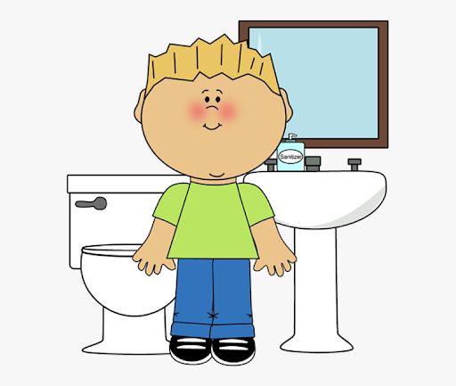
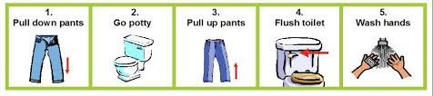
Intimate Care
Please ensure you read and sign to agree to procedures within our intimate care policy
Children at times require support in personal care. Especially in the early years of nursery Those with physical/learning disabilities may require assistance in managing their personal needs. Other pupils, because of accident or illness, may also at some time require such assistance.
Some pupils with additional needs have support staff to assist them in all aspects of school life including personal care while others may rely on the help and goodwill of staff and peers.
Staff will not routinely change your child and you may be contacted to come and take your child home especially if your child is distressed. We would like to reassure parents that their children are cared for and protected.
We will Safeguard the dignity, rights and well being of all of our children, please discuss these procedures with your child’s teacher if you feel your child needs any individualized care.
We will encourage and support your child to be as independent as possible in going to bathroom will support them and encourage parental support in helping them to become confident in their own personal hygiene.

Slide 15





Symptoms
If your child has ANY symptoms of the Corona virus they should stay at home and your household should isolate in accordance with the latest Public Health Agency Advice.
Symptoms include:
Raised temperature (A raised temperature is above 37.5)
Persistent cough
Loss of smell and taste
A staff member to take child’s temperature on entering into the nursery or if symptoms materialize during the day
Parents sign to agree to procedures both within nursery and responsibilities for Covid related procedures in terms of self-Isolating

Slide 16


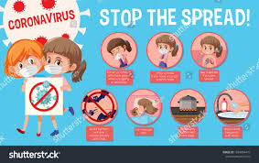

Procedures when responding to a suspected case of Corona virus
Anyone who displays symptoms while in the nursery will be sent home immediately-staff or child
Staff will follow procedures from our isolation policy
The parent will be contacted immediately-please ensure your emergency numbers are up to date.
The child waiting to be collected will be withdrawn from their bubble/class and will wait with one member of staff in our parents room
This room will be well ventilated for safety
Staff member will continue to wear visors as normal and if necessary a mask if a normal distance of 1 metre can’t be maintained.
Gloves and an apron may be worn if contact is necessary

Slide 17


Procedures
Parents must seek testing for their child-link;
https://www.nhs.uk/conditions/coronavirus-covid-19/testing-and-tracing/get-a-test-to-check-if-you-have-coronavirus/
If the child’s test is negative the child can return to nursery, parents may present the negative test result to return back into the nursery
If the child’s test is positive the rest of their bubble-whole class-depending on where we are in the settling in period will be sent home and advised to isolate for 10 days. Staff in this bubble will also be requested to self isolate. (guidance from 3rd term 20/21)
As we are observing guidance on infection, prevention and control, which we hopefully reduce risk of transmission and closure of our whole setting may not be necessary.

Slide 18




Coughs, colds and sickness
If you child has any symptoms, however mild, please stay at home.
Please do not send your child in if they require calpol or other medication(unless on long term medication )
It might be helpful to take your child’s temperature to ensure it is normal before bringing your child to nursery.
Young children when they start nursery tend to pick up normal coughs, colds and viruses and unfortunately it will be difficult to tell them apart, therefore must not attend nursery with any symptoms
Do not be concerned regarding attendance of your child. We will support you in whatever way we can. We will offer blended learning if we find ourselves in any period of isolation .
If in doubt please keep your child at home and always seek testing.

Slide 19


Planning
We enable an environment by offering continuous provision in all 6 areas of play. Our continuous provision gives the children the opportunity to be independent active learners, and to enhance and offer experiences connected to their interests.
Our planning is constantly evolving allowing learning opportunities to grow.
We create and follow monthly plans that show adult led learning
We follow detailed fortnightly planners that are continually adapted to reflect the children’s needs, likes and support the type of learners they are.
We evaluate our plans regularly and this ensures we plan and provide for the children’s next stage of development.
All planners are displayed on the parents notice board, on website and sent out via seesaw

Slide 20
ASSESSMENT AND RECORD KEEPING
We observe children during ordinary moments , noting their verbal/non verbal communication, physical, cognitive skills, used duration at area of play and their concentration level e.g. : are they absorbed in their play. We look at signals of involvements, their energy, creatively, facial expressions , persistence, language and satisfaction.
We Monitor pupils progress throughout the year and keep you informed and give strategies on how you could support your child
Our weekly/fortnightly evaluations inform our future plans
We keep detailed information on every child including photographs that show their learning and development in all 6 areas of play.
Parent settling in meetings are in October, this year will take place by telephone call or zoom if you prefer
Transition forms are completed for primary school of end of year

Slide 21


GDPR General Data Protection Regulations
The General Data Protection Regulation GDPR –a new Eu law -25th May 2018- covers the management and control of personal information.
Replaces the current data protection act 1998.
GDPR will give parents greater control over their own personal data and have a right to complain to the ICO if they are concerned on how we handle data.
GDPR introduced some significant changes in record keeping and processing activities and will be share documentation to show us how and why we process all personal data that we hold on children, parents , staff, governors, volunteers and job applicants.
Reporting a data breach if Data Protection has been put at risk (within 72 hours)
How we gain CONSENT –Encourage parents to actively opt-in and give consent freely to allow us to process any personal data that we hold
GDPR Policy is available on request

Slide 22


CHILD PROTECTION & Safeguarding
Parents will receive a condensed safeguarding policy with an added covid addendum – a full policy may be requested at any time from the office and viewed on nursery website.
Our Safeguarding and child protection policy is updated yearly and this year sees additional information to support families during this pandemic.
Please ensure you read and sign all relevant documentation
If there is a disclosure by a child or parent, we will follow our safeguarding procedures within our policy-see flow charts of procedures
If we have any trips/visitors during the year, parents are requested to complete a code of conduct form to agree to follow safeguarding procedures

Slide 23


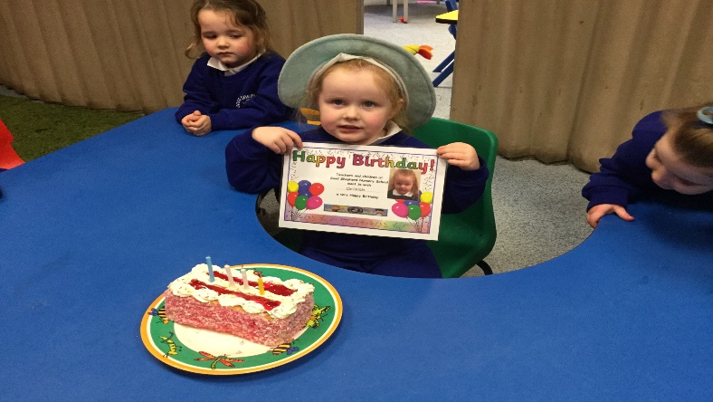

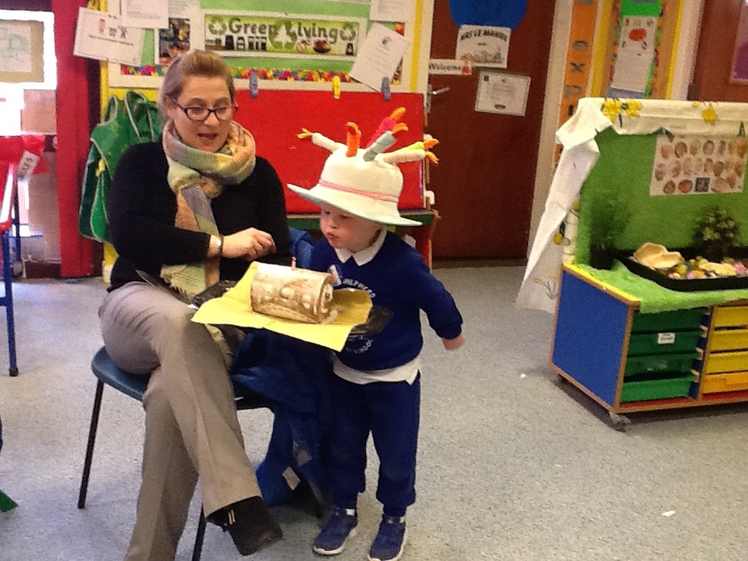
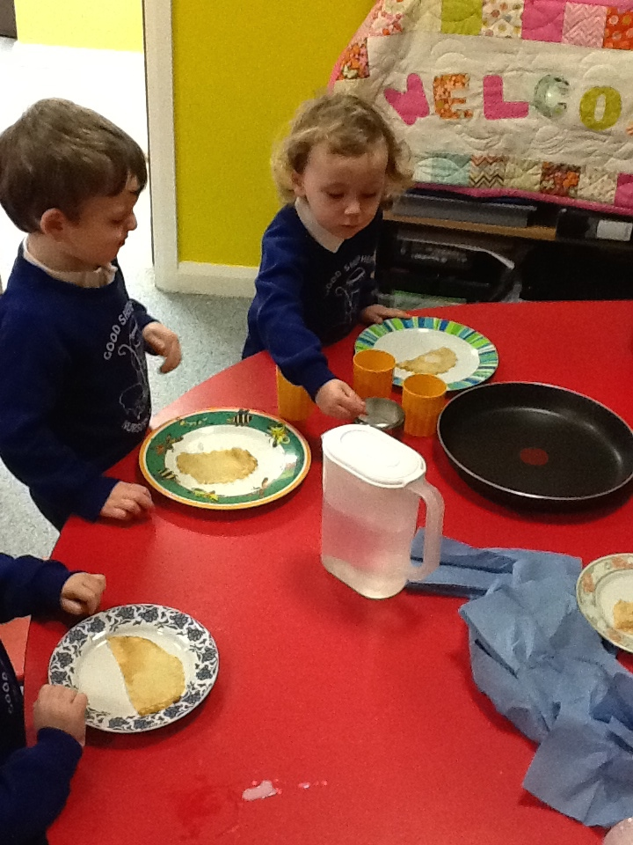
SNACK FUND
Snack fund is £5.00 per week, your child will be given a moneybag on Monday and we would appreciate if this could be returned by Wednesday
Paid dinners are £2.50 per day, please ensure you have completed the entitlement online form ASAP.
This entitlement directly affects the nursery budget, so it is important you apply if you are entitled.
Snack Money is used for a wide variety of items within the nursery such as baking activities ,planting and growing resources, educational visits road shows and buses.
We very much appreciate your contribution.

Slide 24
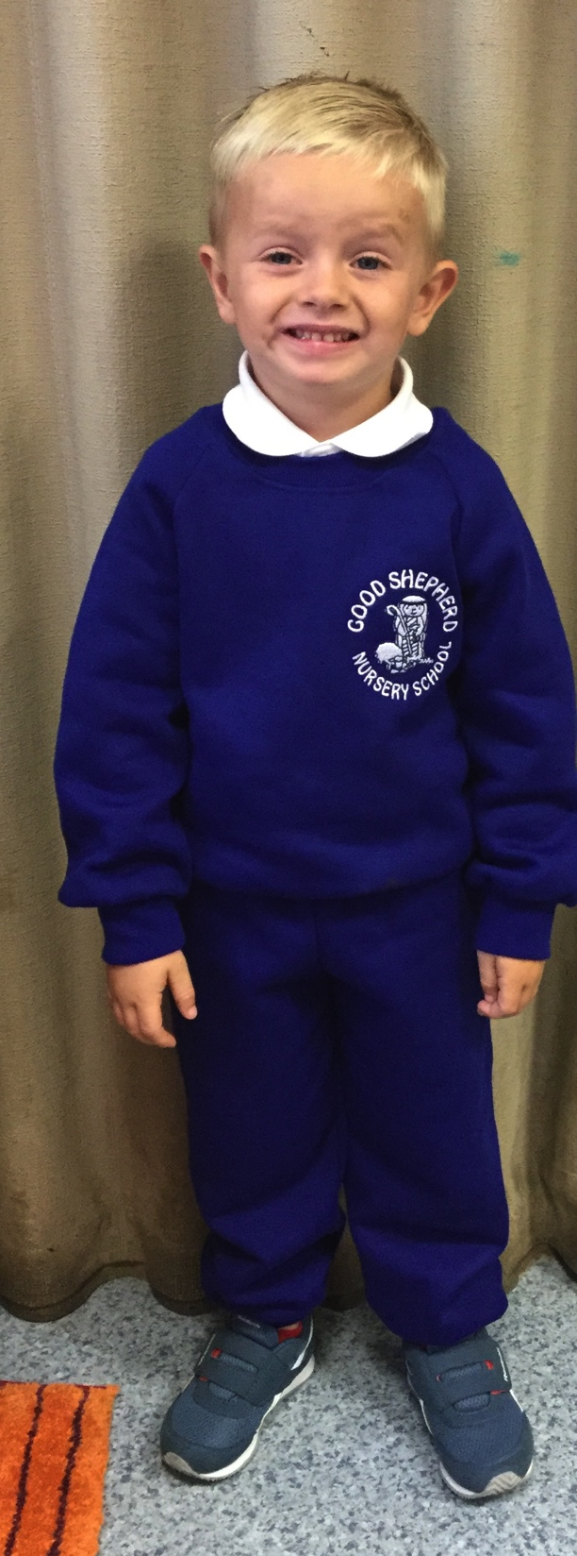
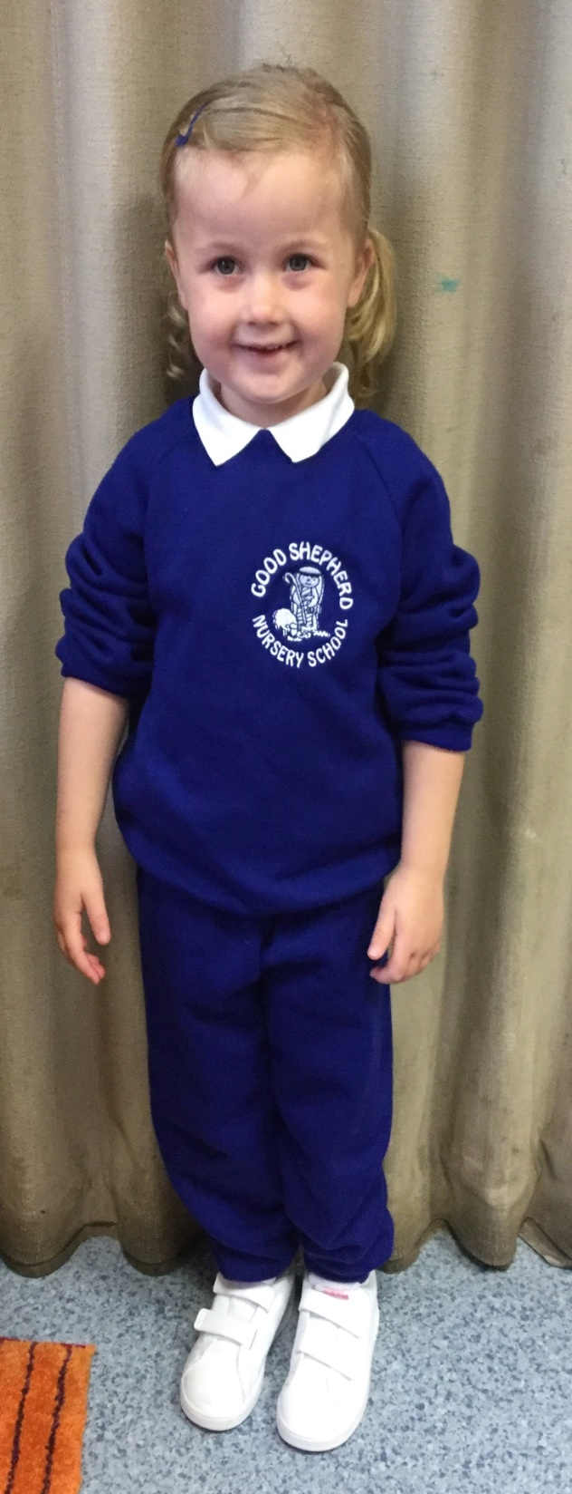
UNIFORMS
BLUE TRACKSUIT AND WHITE T-SHIRT
Saves other clothes
Easily identified on schools trips
No buckles, belts and laces
Sweatshirts size 3-4, 5-6.
Truly Fare (9.99 Sweatshirt, 6.99 Pants & 3.99 Polo shirt)
Please put names on sweatshirts
We would request that parents leave a spare coat in nursery school.

Slide 25




PREPARING YOUR CHILD
Please continue to support your child’s independence by encouraging them to put on and take off coat
Allow them to use a knife and fork when having dinner
Teach them to wash their hands correctly
Teach them how to blow and wipe their nose and put the used tissue in the bin
Teach them how to use a pedal bin
Show and teach them to flush the toilet
Please dump the dummies and bottles
Encourage them to walk instead of using a buggy.

Slide 26

This is an app that keeps you informed of everything that happens in the nursery setting .Unfortunately parents will not be allowed into the setting because of the COVID restrictions ( we will continue to update procedures as guidance changes )
Throughout the school year, Seesaw builds an organized, digital portfolio of each Childs’ learning, accessible by teacher, child and parent.
Seesaw keeps parents in the loop by giving them a real-time, personalized glimpse into their child’ s school day,
Parents only get updates for their child and can only view their child’s journal
Sometimes we will send a picture home with a number of children tagged in it.
Please ensure you have signed our social media policy agreement and agreement in how we use photographs to consent to this.

Slide 27

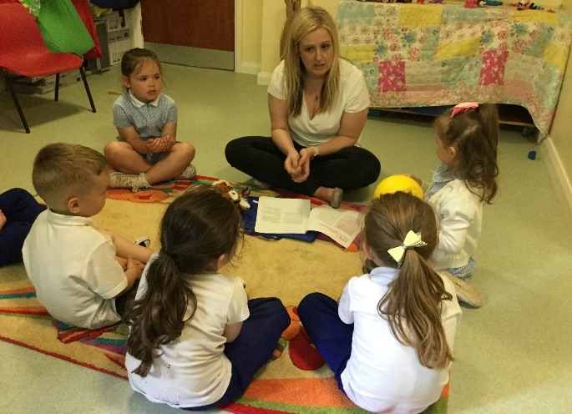
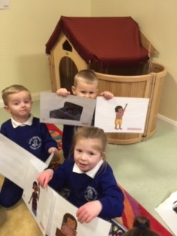

Extended schools
Within the normal nursery school day, extended school funds will support the delivery of additional speech support for those children attending or requiring additional support/activities or programmes.
These activities are closely linked with new Early Talk Boost Programme that we have been implementing over the last number of years
Benefits of withdrawal activities are huge
Smaller groups allow children more opportunities to express themselves and create further opportunities to develop communication skills
The activities teach and enhance skills by building on the child’s existing knowledge and increasing opportunities to allow consolidation through activities
These sessions will develop social skills eg. eye contact, looking and listen ,co-operative play etc
We hope to facilitate an afterschool later in the term depending on circumstances.
We will work with the primary school to access the breakfast club facilities for early drop off

Slide 28



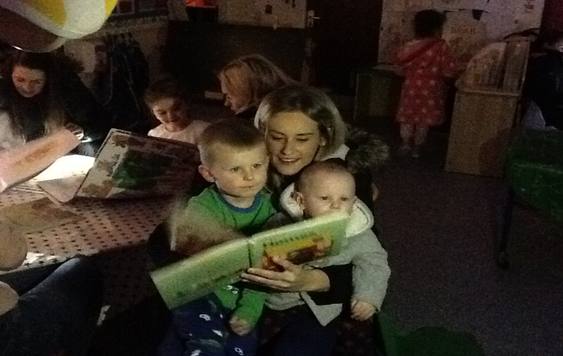

Good Shepherd Welcomes
Big Bedtime Read and Education Works
Good Shepherd Nursery have been successful in receiving funding for a number of years from the Department of Education to implement a
“Big Bedtime Read” and “Education works” programme
We work and involve parents in supporting and encouraging children to learn through regular bedtime story reading. We will have a number of parental workshops-hopefully virtually throughout the year to highlight the importance of a good bedtime routine and the learning experience that can be developed.
We are encouraging children’s parents to get involved and get some tips on reading to your child.
Weekly use of our Story bags purchased through this funding.-for now this will not be possible though will introduce this ASAP
In additional ,we have received funding to help support your child in the area of maths, we will offer parent maths workshops and opportunities to work with your child within the nursery .(virtually )
Parents as Partners!!

Slide 29



online Safety
Please ensure you read, agree and sign to the following policies.
Use of Images policy and agreement
‘Social Media “ Policy
Parental Agreement Contract

Slide 30

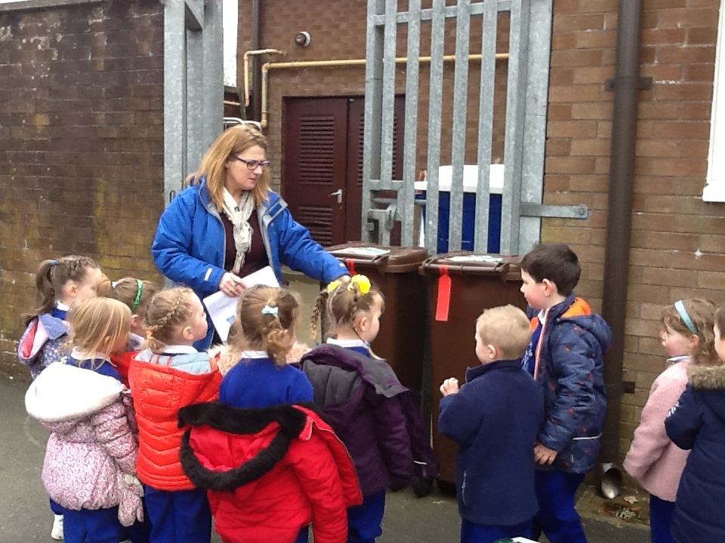
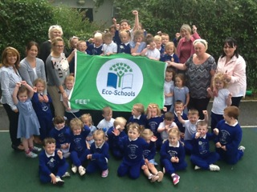
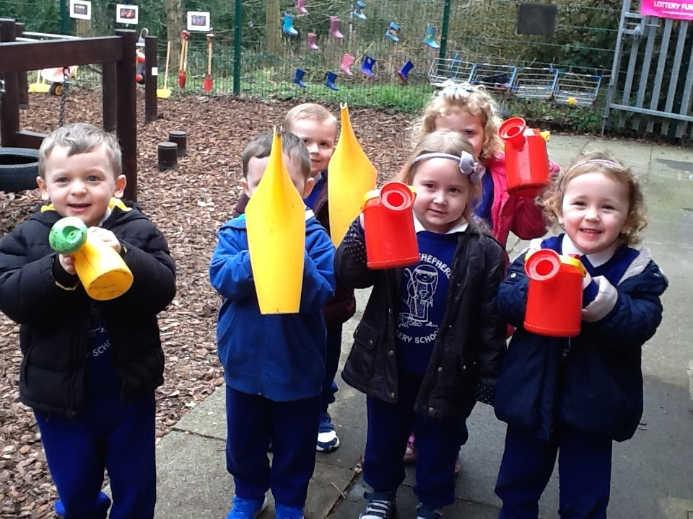
Eco-Schools
Good Shepherd Nursery is an Eco-school.
Benefits
Educate children from young age.
Links to world around us
Topic waste, litter, energy, biodiversity.
Pride in local community – links.
Interwoven into our areas of play.
Achieved our 3rd Eco Flag with the support from our Parent Eco-committee

Slide 31
NI forest school NIFSA
The Northern Ireland Forest School Association (NIFSA) has been developing Forest School programmes in Northern Ireland since 2008
The Learning Without Walls initiative is the vision of Lady Dufferin and the collaboration of the Dufferin Foundation and the Northern Ireland Forest School Association (NIFSA).
Children are suffering from nature deficit disorder, a term used by Michael Louv in his book "Last Child in the Woods". Evidence is showing that children are suffering from serious mental and physical health issues because they are not spending time outside.
Good Shepherd Nursery has been privileged to be involved in The Learning With Out Walls Initiative , we have begun through the forest school Awards to train 2 members of staff to become Forest Rangers!

Slide 32

Parents as Partners
If you have any concerns about your child, however small, let us know.
Our Open-door policy exists for the time being as a virtual one, so please contact us by phone, email or private message on see-saw
Whilst Parental involvement in nursery life this term will be very different from “usual”, we still very much need your support to ensure we have a successful year.
We will do our utmost with social distancing and other COVID measures in place, to make you and your child feel welcomed, happy, safe and nurtured.
Many thanks for taking the time to read through information and presentation. We look forward to meeting you and your child in the new nursery year!
Mrs le Mahieu-Principal.

